Slide 1
Classroom Language

Slide 2
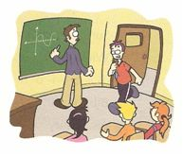
Good Morning / good Afternoon /good Evening

Slide 3
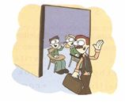
Good bye / see you / bye

Slide 4
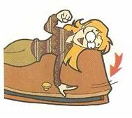
Close the door

Slide 5
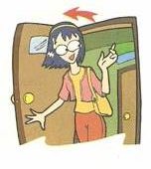
Open the door

Slide 6
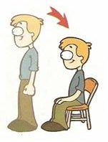
Sit down

Slide 7
Stand up

Slide 8
Hello / Hi
Hello!

Slide 9
Raid your hand

Slide 10
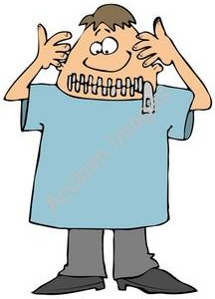
Silent please

Slide 11
English
1) Hello 2) Good morning 3) Good afternoon 4) Good evening 5) What is your name? 6) My name is… 7) Nice to meet you. 8) See you later. 9) See you tomorrow. 10) It’s a pleasure.
Spanish
1) Hola 2) Buenos días 3) Buenas tardes 4) buenas noches 5) Cuál es tu nombre? 6) Mi nombre es… 7) Mucho gusto. 8) Hasta luego. 9) Hasta mañana. 10) Es un placer

Slide 12
Answers
What do you say in the morning?
What do you say in the afternoon?
What do you say evening?

Slide 13
Hello, who are you? What´s your name?
I´m Mary, nice to meet you
Nice to meet you too

Slide 14
Who are you?
My name is ………………..
What’s your phone number?
My phone number is ………………
What’s your address?
My address is………………

Slide 15
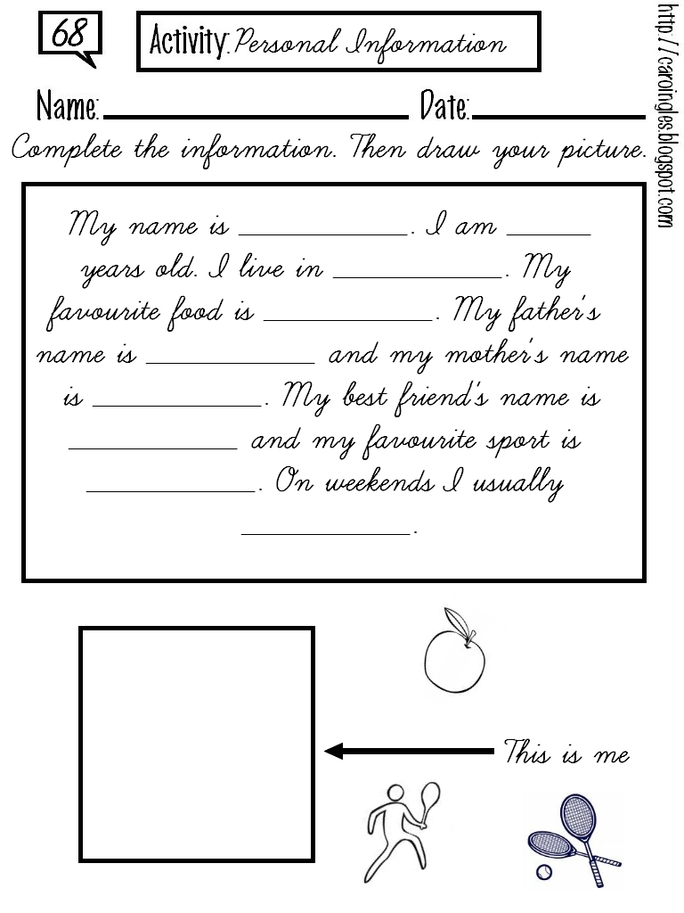

Slide 17
It´s banana!
You´re welcome
Hi, I´m Alice

